Slide 1
HR Sytem Application
Only for Process Data Teacher

Slide 2

Background

Slide 3

Purpose

Slide 4
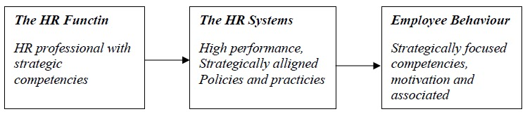
Benefit

Slide 5
Features
Input Data Guru
Display Data Guru
Delete Data Guru
Masukkan Data Absen Guru
Menghitung Gaji Bulanan(Gaji Bersih, Potongan, Gaji Kotor)
Menghitung Bonus Tahunan Berdasarkan Tahun Masuk

Slide 6
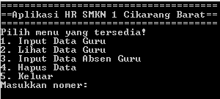
Display Application

Slide 7
DEMO

Slide 8


